Slide 1
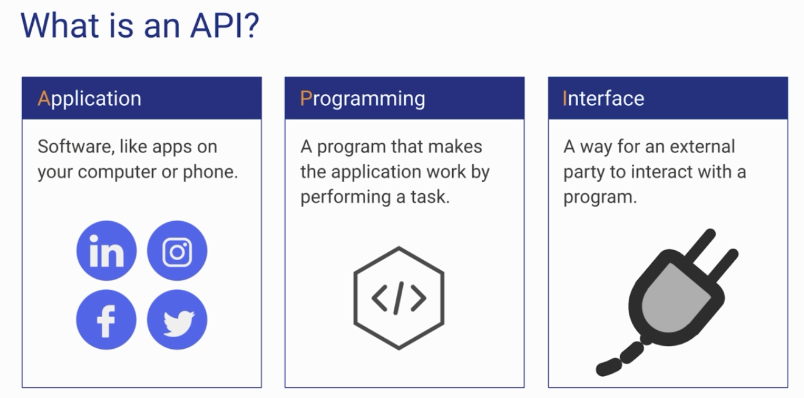
What is an API?

Slide 2
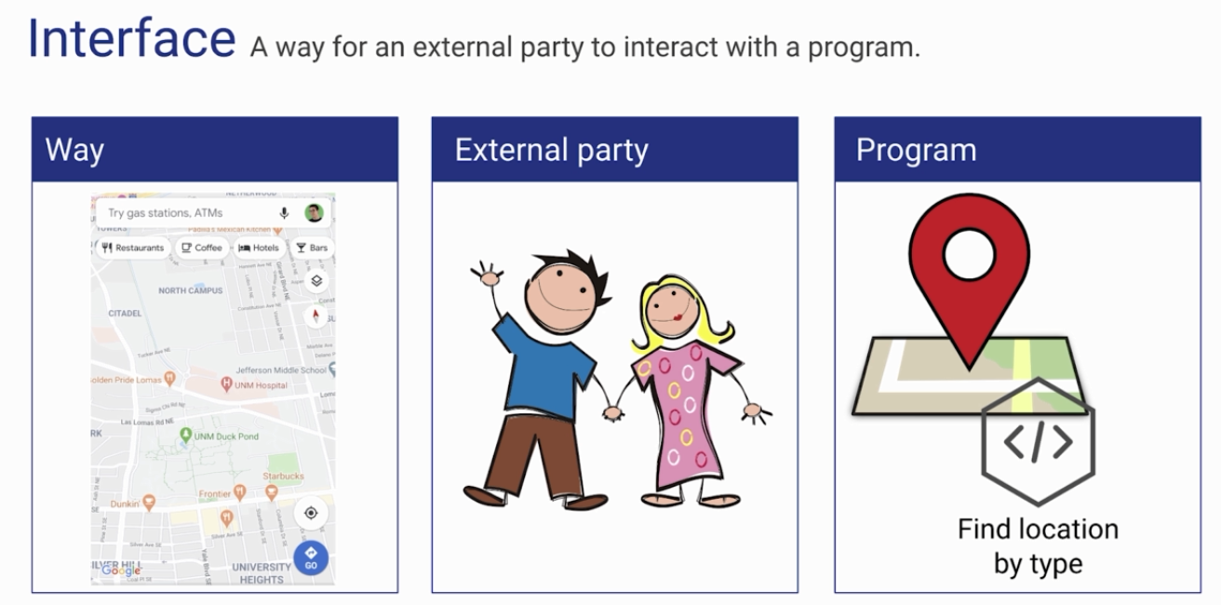
What is an API?

Slide 3
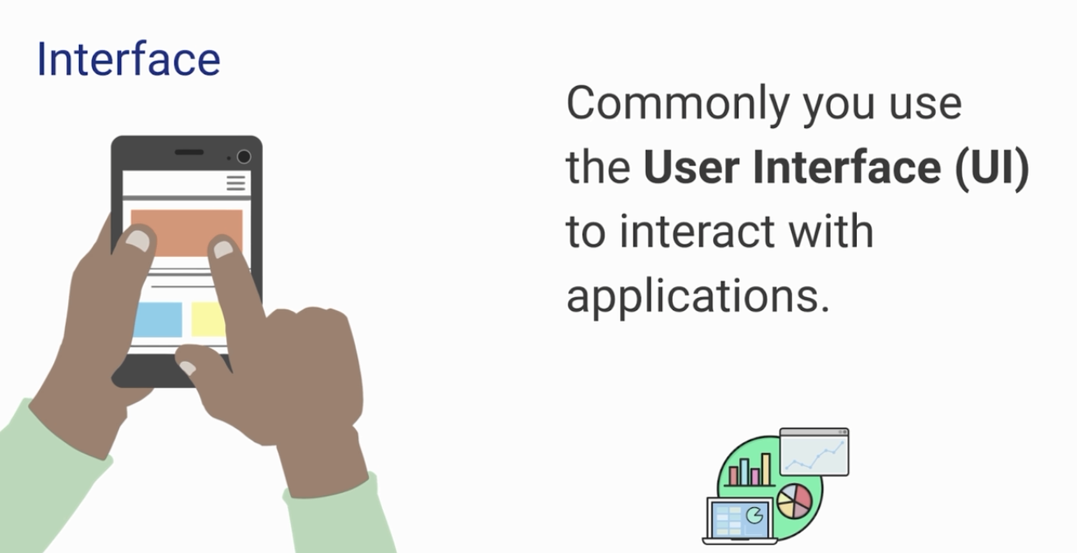
What is an API?

Slide 4
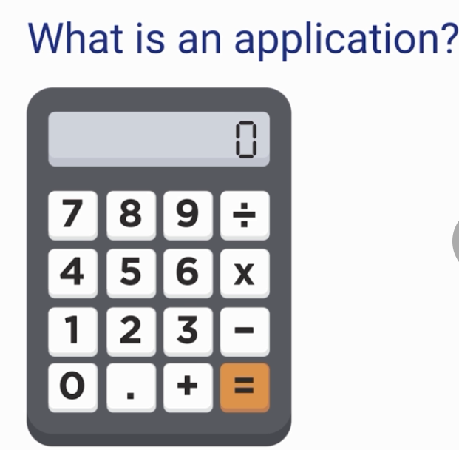
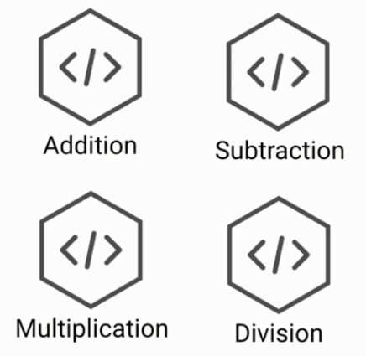
What is an API?

Slide 5
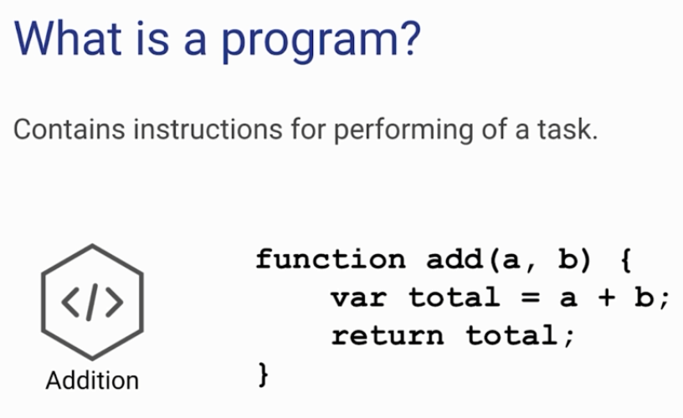
What is an API?

Slide 6
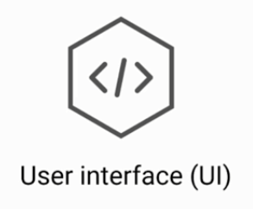
What is an API?

Slide 7
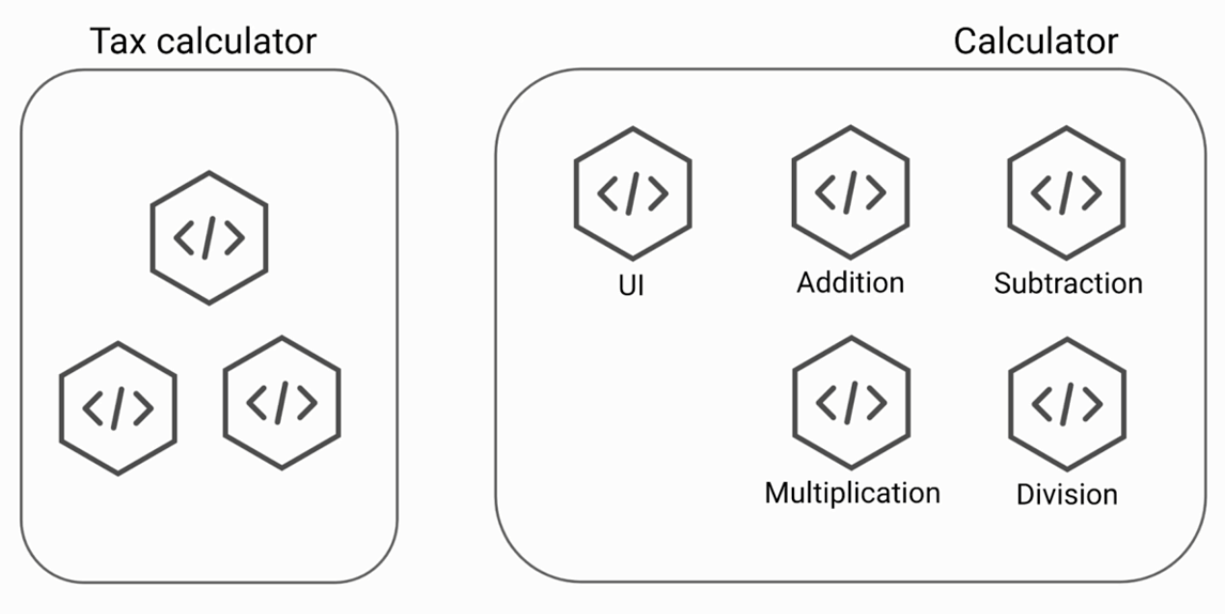

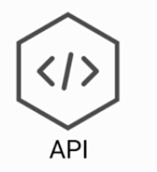

What is an API?

Slide 8
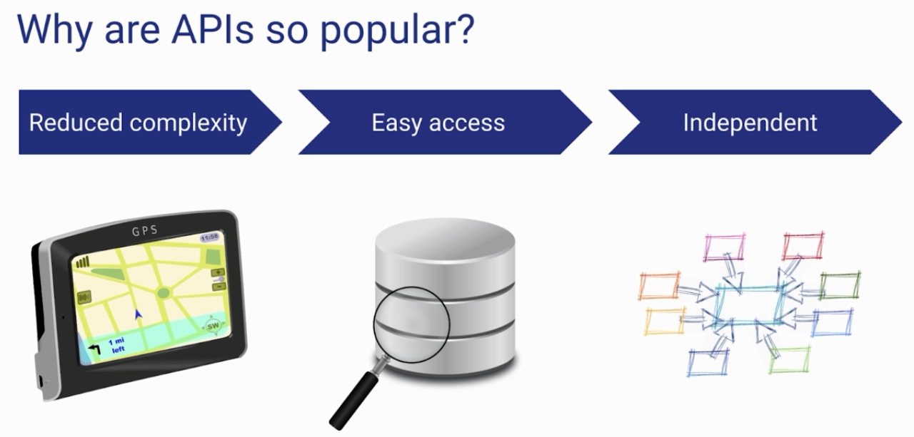
What is an API?

Slide 9
Before Spring Boot
https://www.udemy.com/course/introduction-to-apis-rest-api-graphql-soap-web-services-grpc/learn/lecture/19537442#overview

